Slide 1
CS 316: Introduction to Deep Learning
Inception, Batch Normalization, ResNet, DenseNet
Week
Dr Abdul Samad

Slide 2
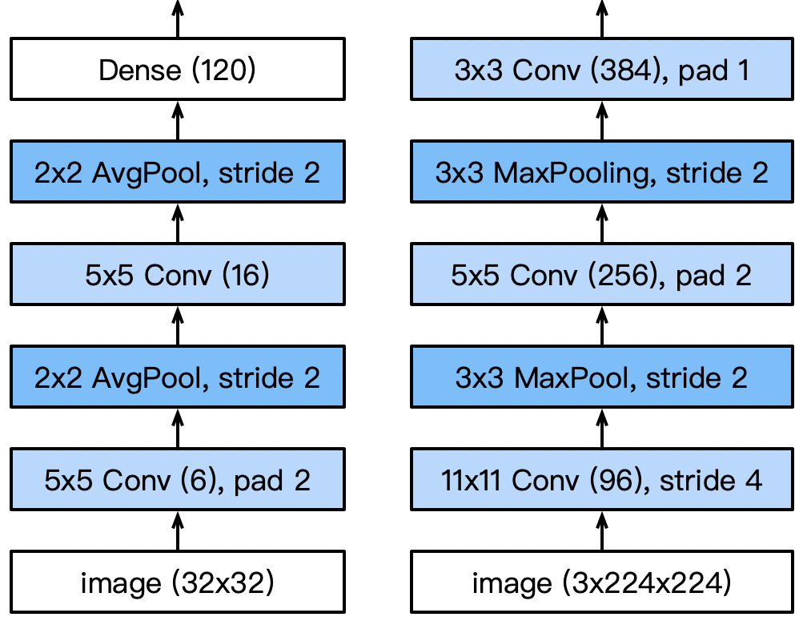
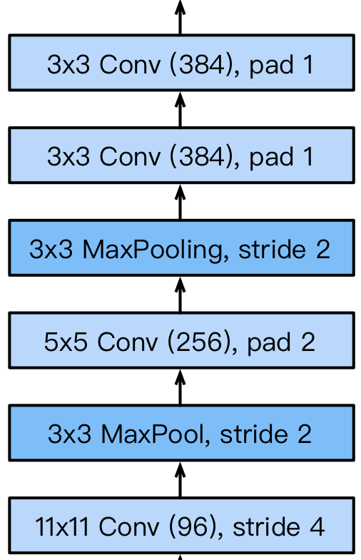
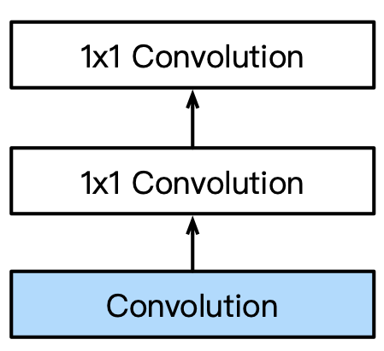
Picking the best convolution …
1x1
3x3
5x5
Max pooling
Multiple 1x1
LeNet
AlexNet
VGG
NiN

Slide 3
Why choose? Just pick them all.

Slide 4
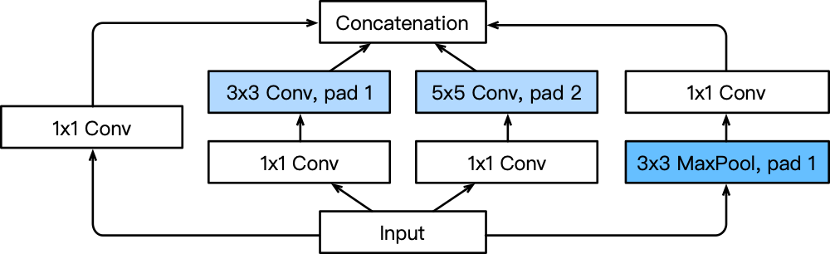
Inception Blocks
4 paths extract information from different aspects, then concatenate along the output channel
Same width/
height as input
Extract with
different spatial size convolutions
Extract spatial info with pooling

Slide 5
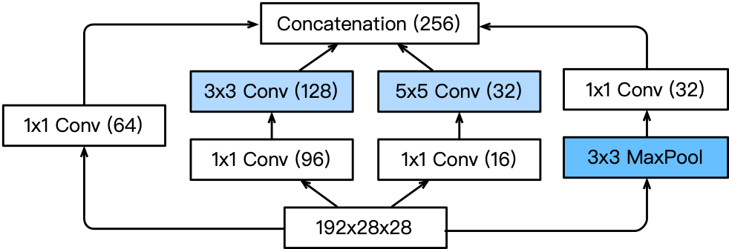
Inception Blocks
The first inception block with channel sizes specified
Allocate various capacities to each channel
Reduce channel size to lower model capacity

Slide 6
Class Activity
 | #parameters
Inception
3x3 Conv
5x5 Conv

Slide 7
Inception Blocks
Inception blocks have fewer parameters and less computation complexity than a single 3x3 or 5x5 convolutional layer
Mix of different functions (powerful function class)
Memory and compute efficiency (good generalization)
 | #parameters
Inception | 0.16 M
3x3 Conv | 0.44 M
5x5 Conv | 1.22 M

Slide 8
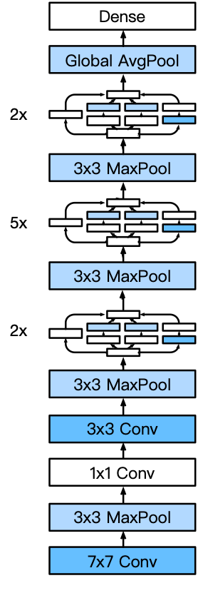
GoogLeNet
Output
Stage 5
5 stages with 9 inceptions blocks
Stage 4
Stage 3
Stage 2
Stage 1

Slide 9
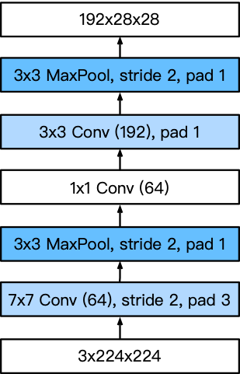
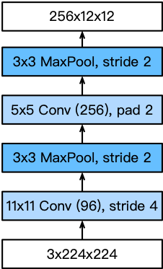
Stage 1 & 2
GoogLeNet
AlexNet
Smaller kernel size and output channels due to more layers

Slide 10
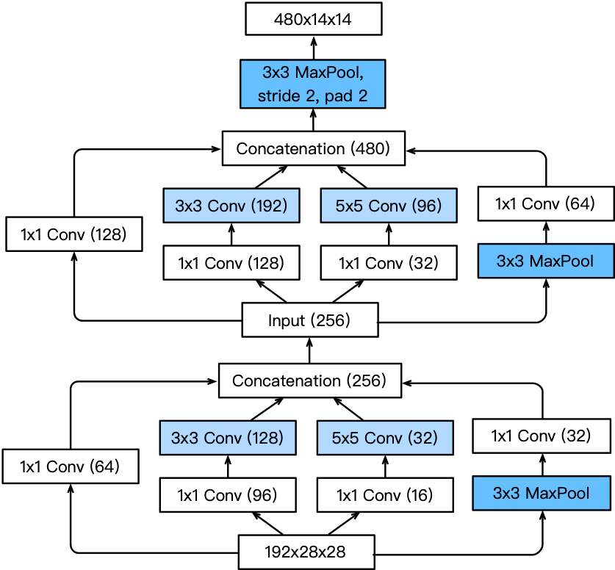
Stage 3
Increased
output channel
Channels
allocation is different

Slide 11
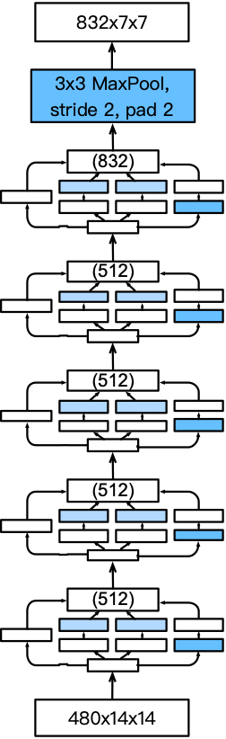
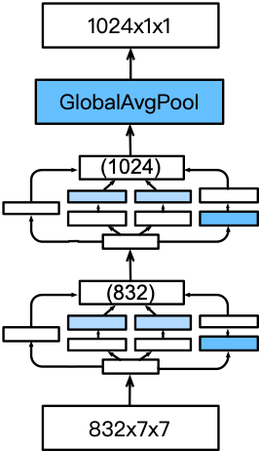
Stage 4 & 5
Increased
output
channel
1024-dim
feature to
output layer
Increased
output
channel
Increased
output channel

Slide 12
The many flavors of Inception Networks
Inception-BN (v2) - Add batch normalization
Inception-V3 - Modified the inception block
  Replace 5x5 by multiple 3x3 convolutions
  Replace 5x5 by 1x7 and 7x1 convolutions
  Replace 3x3 by 1x3 and 3x1 convolutions
  Generally deeper stack
Inception-V4 - Add residual connections (more later)

Slide 13
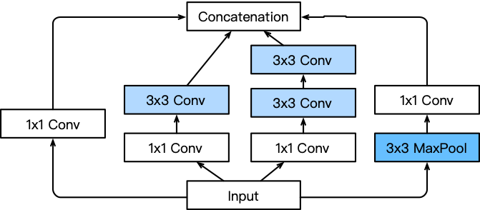
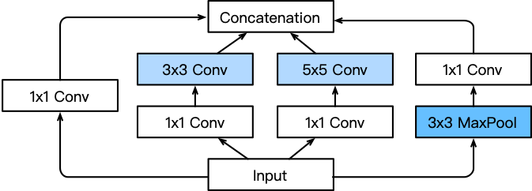
Inception V3 Block for Stage 3

Slide 14
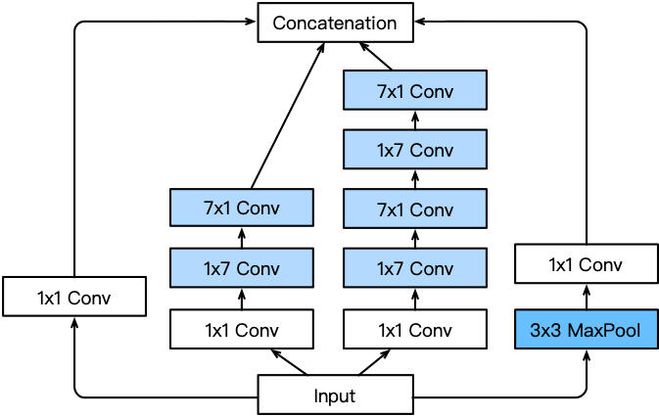
Inception V3 Block for Stage 4

Slide 15
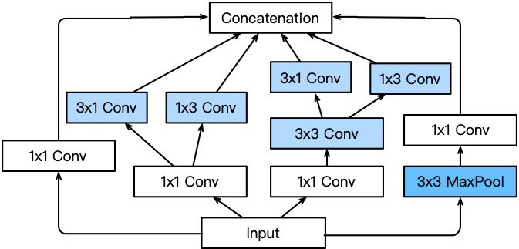
Inception V3 Block for Stage 5

Slide 16
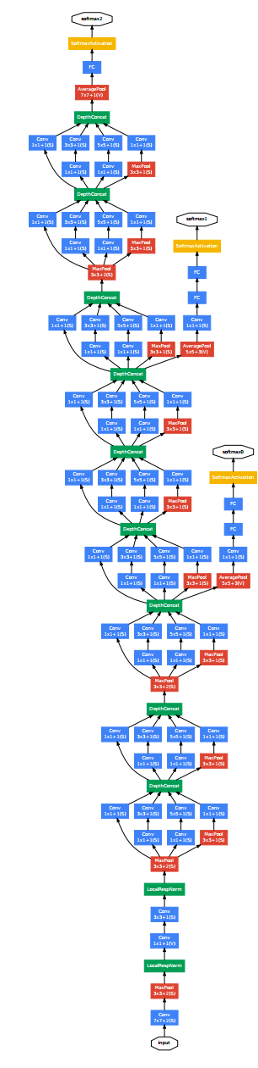
Batch Normalization
loss
Loss occurs at last layer
  Last layers learn quickly
Data is inserted at bottom layer
  Bottom layers change - everything changes
  Last layers need to relearn many times
  Slow convergence
This is like covariate shift
Can we avoid changing last layers while
learning first layers?
data

Slide 17
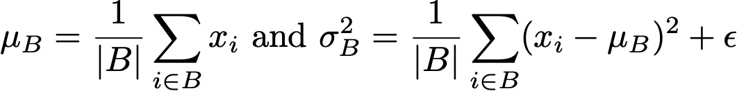
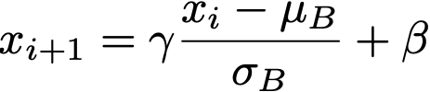
Batch Normalization
loss
Can we avoid changing last layers while
learning first layers?
Fix mean and variance
and adjust it separately
mean
variance
data

Slide 18
This was the original motivation …

Slide 19

What Batch Norms really do
Doesn’t really reduce covariate shift (Lipton et al., 2018)
Regularization by noise injection
  Random shift per minibatch
  Random scale per minibatch
No need to mix with dropout (both are capacity control)
Ideal minibatch size of 64 to 256

Slide 20
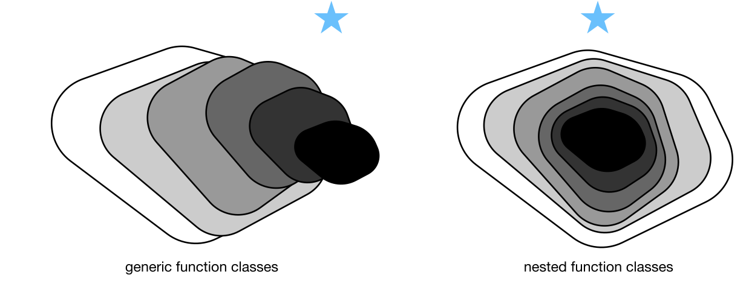
Residual Networks

Slide 21
Does adding layers improve accuracy?
✔︎
?

Slide 22
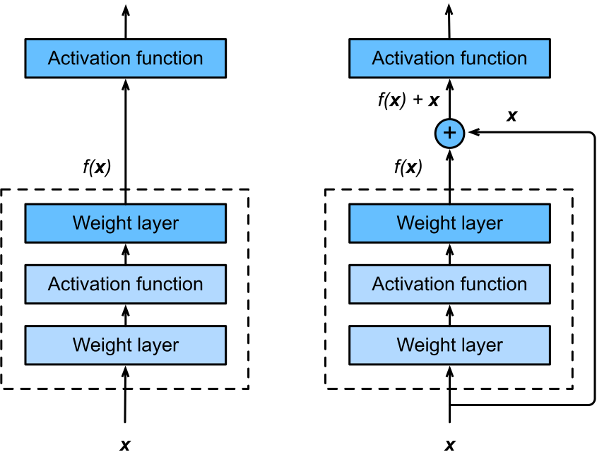
Residual Networks
Adding a layer changes function
class
We want to add to the function class
He et al., 2015

Slide 23
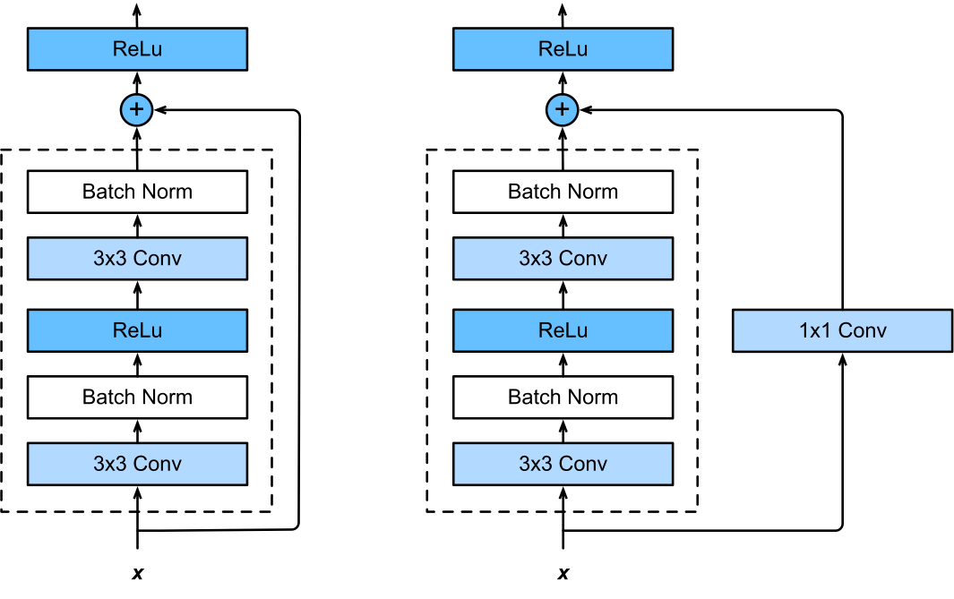
ResNet Block in detail

Slide 24
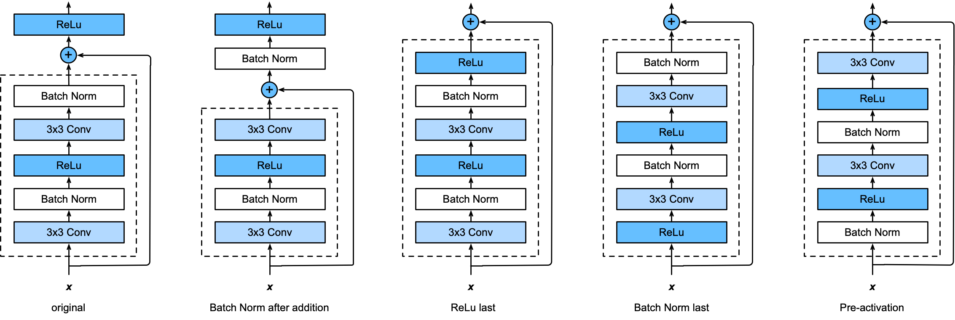
The many flavors of ResNet blocks
Try every permutation
Try every permutation
Try every permutation

Slide 25
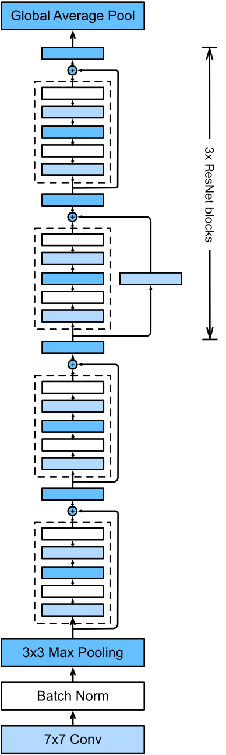
Putting it all together
Same block structure as e.g., VGG or Google Net
Residual connection to add to expressiveness
Pooling/stride for dimensionality reduction
Batch Normalization for capacity control
… train it at scale …

Slide 26
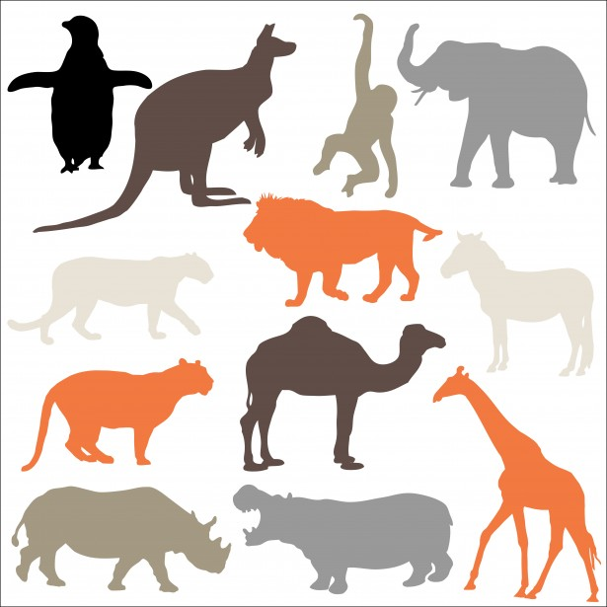
More Ideas

Slide 27
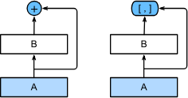
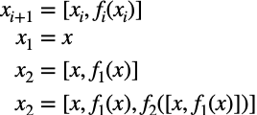
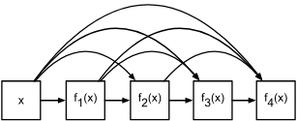
DenseNet (Huang et al., 2016)
ResNet combines x and f(x)
DenseNet uses higher order
‘Taylor series’ expansion

Slide 28
Summary
Inception
  Inhomogeneous mix of convolutions (varying depth)
  Batch norm regularization
ResNet
  Taylor expansion of functions

